Slide 1
Multi-letter Substitution (Playfair)
Dr. Waleed Khalid

Slide 2
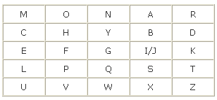
Playfair cipher
Algorithm description
Choose a keyword, “MONARCHY” in this example, and arrange
the letters in a matrix starting with the keyword, then the rest of the
letters sequentially, Considering that I and J are the same letter.

Slide 3
Playfair cipher, Encryption rules:
1- Repeating plaintext letters that are in the same pair are
Separated with a filler letter, such as x, so that balloon
would be treated as ba lx lo on.

Slide 4
Playfair cipher, Encryption rules continued:
2- Two plaintext letters that fall in the same row of the matrix
are each replaced by the letter to the right, with the first
element of the row circularly following the last. For example,
“ar” is encrypted as “RM“.

Slide 5
Playfair cipher, Encryption rules continued:
3- Two plaintext letters that fall in the same column are each replaced by the letter beneath, with the top element of the column circularly following the last. For example,
mu is encrypted as CM.

Slide 6
Playfair cipher, Encryption rules continued:
4- Otherwise, each plaintext letter in a pair is replaced by the letter that lies in its own row and the column occupied by the other plaintext letter. Thus, hs becomes BP and ea becomes IM (or JM, as the encipherer wishes).

